Slide 1
Business Analysis
Digital – R1.2 Requirements Approach
Sherry McMillan
Sr Manager, Business Analysis
January 26, 2022

Slide 2
Requirements Assessments & Recommendations
My Approach | Status
Requirements Assessment & Recommendations | The goal for this meeting is to ensure we have agreement and then implement asap, e.g. starting on Monday.
Hire a BA Lead For the time being Gerry Weber continues to handle the day-to-day assignments for the Digital BAs | Done. Ciara Whelan starts Feb 14th
Hire a BA with deep commercial knowledge (Individual Contributor) | In Progress. Several candidates are in the pipeline. Proceeding to second interviews next week.

Slide 3
Recommendations – Immediate Next Steps
  Define and train out ownership for BA Responsibilities
  Improve the efficiencies of meetings
  Transparency and tracking of deliverables
  Level set with both CWB and Temenos Teams in a joint meeting.

Slide 4
What Does Success Look Like
      We have a common understanding of
        What the Business Need is
        How the solution is filling it
      All stakeholders can easily find the answer to the points above
        We don’t need to ask “What did we decide?”
        The answers are complete, correct, and consistent (no missing or conflicting documentation)
      Dev has what they need to code
      QA has what they need to test
      We all have what we need to support and maintain (or even enhance) the solution in the future.

Slide 5
1. Ownership of BA Tasks and Deliverables
Owned by: Digital BA Lead
See also Digital – Requirements Workflow – Current and Future State – Overview
Note: This principle can be applied across disciplines - UX etc.
Case | Temenos BA |  | CWB BA | CWB BA | Notes
 | Task | Deliverable | Task | Deliverable
Infinity Out Of The Box (OOTB) | Demo. Available for Q&A | *Provide Existing Requirements. *Recorded Demo. | Work with Business to verify that OOTB will meet the need. (Ultimately a Business decision). | Trace Temenos Deliverables to CWB Business Need. | *Note: QA is an important consumer of this information. *Storage location TBD.
Infinity – With Customization | *Demo OOTB. *Document Customization, e.g. User Story and Mock-up | *User Story that covers the modification. *Mock-Ups *Recorded Demo if modification jumps off of unchanged design with no requirements. | *Verify that customization is necessary *Review, provide feedback on, and ultimately validate Temenos requirements. *Trace Temenos Deliverables to CWB Business Need. | * Trace Temenos Deliverables to CWB Business Need. *Transition to Operations (TTO) | *Note: QA is an important consumer of this information. *Storage location TBD.
Not Infinity - e.g. Integration | TBD | TBD | *All necessary for requirements creation *Work with the consumers of the requirements to understand the level of detail needed applying BA Best Practices. | *BR, FR, NFRs and other BA artifacts as needed. *Traceability Matrix. *TTO | TBD: Are the deliverables above sufficient for our integration needs?

Slide 6
2. Improve Efficiency of Meetings
Owned by: Project Manager
  Temenos to give at least 2 business days lead time on meeting agendas
    Ideally, CWB drives the meeting schedule.
  CWB to ensure that the right people are in those meetings.
    Can we have admin support on scheduling those meetings?
  Both Temenos and CWB team members to come prepared to address the meeting topics for the scheduled meeting.
  Use a visual aid to clearly state what action we’re talking about, who owns it, current status, and next steps.
    See #3
  Begin each meeting/agenda item with a stated goal
  Shorter meetings, e.g. 2 hours daily
    To give people time to work on their deliverables
    To ensure that attendees can focus and be efficient
  Nice to have:
  Meetings named insightfully – Is it a Requirements Review meeting or a Requirements Status meeting?

Slide 7
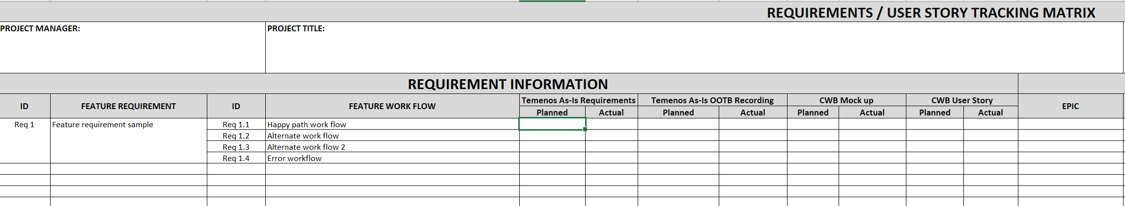
3. Transparency and Tracking of Deliverables
Owned by:
BA Deliverables (CWB and Temenos) – BA Lead
Other Deliverables – Project Manager
Note: Can report on this, e.g. weekly.
Can work as a Requirements Management Plan as well.
Stakeholders and other info to be added.
DRAFT

Slide 8
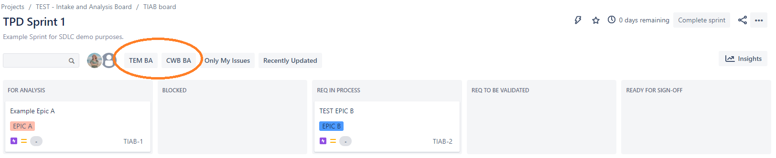
3. Transparency and Tracking of Deliverables
Could also be accomplished using Jira Dashboards, e.g.
Sandbox: TIAB board - TIAB board - Agile Board - Jira (atlassian.net)
DRAFT

Slide 9
Appendix
Inputs
Digital – Requirements Workflow – Current and Future State Overview
BA Deliverables
BA in a Nutshell
Simplified BA Workflow

Slide 10
Inputs
Christina Mullin | Jason Bond | Daniel Pedersen
Dilshad Bhatti | Gerry Weber | All CWB BAs
Michael Schultz | Adam Skoreyko | Sharon Rousey
CWB QA Managers | Sandra Murillo Paz | Daniel Cook
Neil Colinares | More…

Slide 11
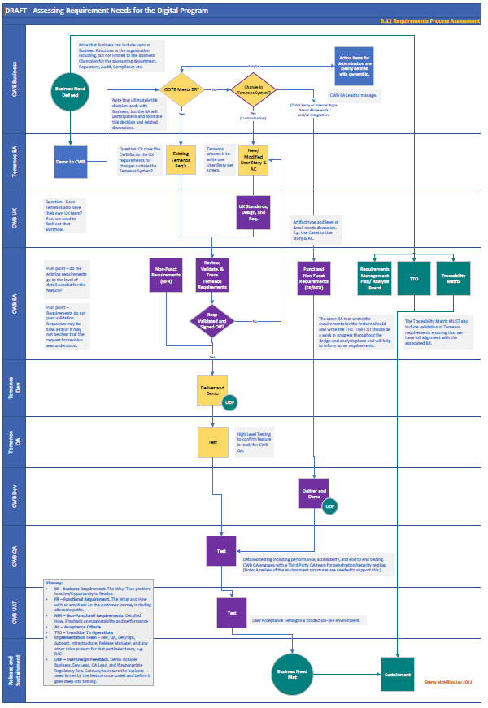
Living Document link – Requirements Workflow – Current and Future State – Overview

Slide 12
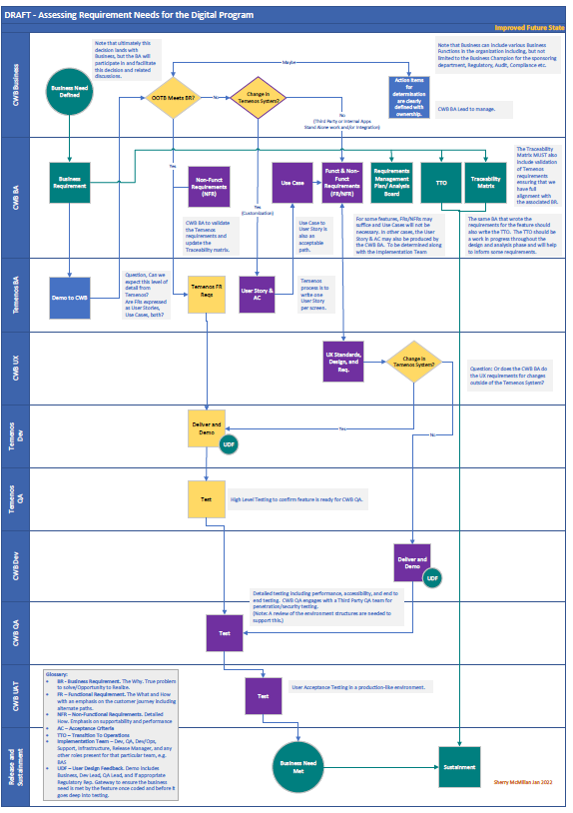
Living Document link – Requirements Workflow – Current and Future State – Overview

Slide 13
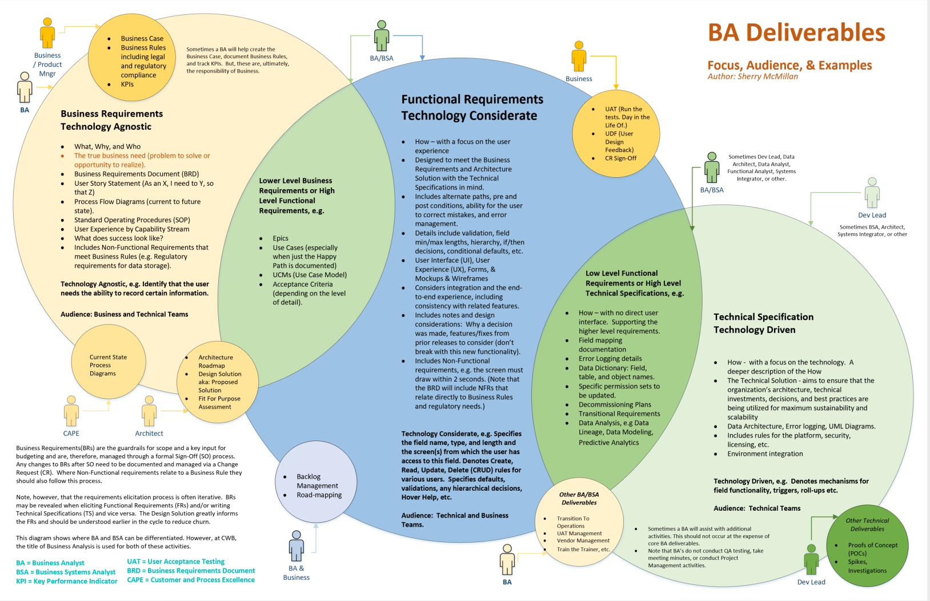

Slide 14
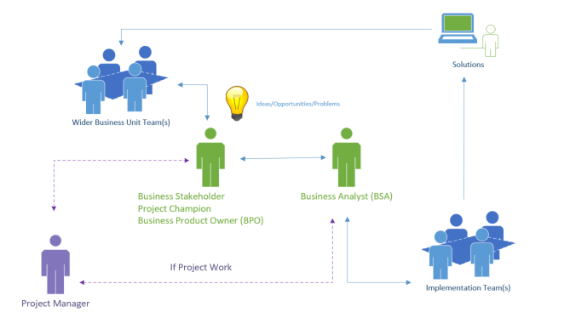
Business Analysis in a Nutshell - Projects

Slide 15
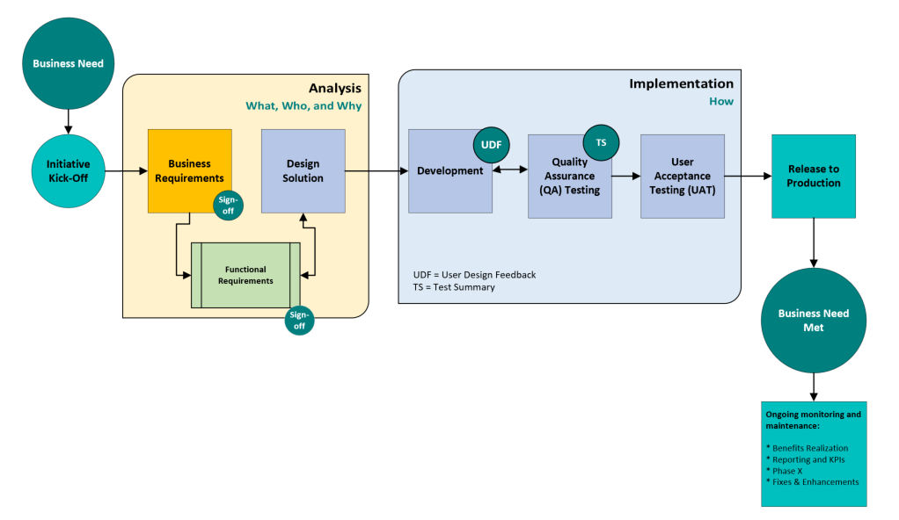
Simplified Business Analysis Workflow
Add UDF to our SDLC Workflow
Action Items:
Q122 - Feedback and formalization with IS, PMO, and other stakeholders.
Train and document.
2022
Implement UDF
Add Regulatory checks to UDF (NRAP and Risks identified in the Business Process Catalog).
Add Benefits Realization to UDF
With Action Items. See also: Business Analysis Value Add - BA Service Catalog
Deliverables: Transition to Operations (TTO)
Opportunities and Pain Points: More lead time is needed.
Action Items: Work with the PMO to resource at the right time in the initiative.
Deliverables: BRD or BRD Light
Opportunities and Pain Points:
Varying expectations for the required level of detail
Ensure we understand the business need before solutioning.
Requirements Repository
Action Items:
Separate BRs from FRs – refining the sign-off to the appropriate stakeholders for each. Add Sr Mgr, BA to the signers.
Decision Tree on where BRD or BRD Light is needed
Implement SDLC Tools – Project Kick-Off on Jan 14th 2021.
Integrate the new Business Process Catalog
Trace to the Benefits Realization
Improve Regulatory Requirements Traceability
Ensure new Security Standards are addressed.
Ensure we follow Accessibility standards.
Deliverables: Various Other Deliverables. See the Service Catalog.
Opportunities and Pain Points: Varying expectations on the level of detail expected.
Estimates and Dates
Action Items:
Update the Service Catalog.
Clarify the criteria for each deliverable.
High level (PMO/Business driven) estimates to be refined by the Implementation Team once the solution is solidified.
Deliverables: Operational Initiatives
Opportunities and Pain Points: Creation of public, published, and prioritized backlogs.
Action Items: Part of the SDLC Tools initiative.

